Slide 1
FROM PIPELINES TO PRODUCTION · DAY 1 · 11:00–12:15 · HANDS-ON ANCHOR
M2 · Data Analysis
FreshMart: what is really happening in our stores?
Pandas EDA · automated profiling · distribution, correlation and cohort analysis · choosing the right chart and library
BITS Pilani WILP · CSIS · Prof.Febin A Vahab
Notes:
The hands-on anchor, 75 minutes. Participants work in a freshmart_m2 folder inside ~/freshmart, same environment. Suggested pace: 5 minutes framing (slides 2–5), then five missions of about 12 minutes each, each briefed with its slide and closed with its coded challenge, and 5 minutes on the hand-off to Lab 1.

Slide 2
WHERE WE ARE IN THE PIPELINE
Discover: look before anyone builds
Discover
Prepare
Build
Serve
Monitor
Re-execute
Release
M2
Lab 1
Lab 2
Lab 3
Lab 4
Lab 4
Lab 5
Everything built for the next two days rests on what this session finds in FreshMart's raw data.
02
From Pipelines to Production · Day 1 · M2 Anchor
Notes:
M2 is the Discover beat. Its output is not a chart but a data requirement: the grain and quality rules Lab 1 turns into a contract at 13:15. Data analysis and visualization are also taught as a craft in their own right, for the analytics courses in the portfolio.

Slide 3
MONDAY MORNING -AT FRESHMART-THE HEAD OF SUPPLY CHAIN
“Sales are up, but some stores report more stockouts.I do not want another dashboard.”
“I want to know what is actually happening, which stores and products drive it, and what evidence supports the conclusion.”
Your role : Data Analyst / Analytics Engineer
Your mission : Investigate → explain → quantify → hand off
03
From Pipelines to Production · Day 1 · M2 Anchor
Notes:
The FreshMart situation from the M2 handout. Your role is Data Analyst or Analytics Engineer. Note the explicit refusal of 'another dashboard': the deliverable is evidence and a recommendation, and every chart today must answer a stated question.

Slide 4
THE QUESTION BEHIND M2
Before we predict reorder propensity…
We need to answer:
What actually arrived?
Can we trust it?
What patterns are really present?
Which stores/products drive those patterns?
What must exist reliably for the next stage?
What is really happening in FreshMart's data — and what must exist reliably before anyone can predict reorder propensity?
04
From Pipelines to Production · Day 1 · M2 Anchor
Notes:
The primer from the M2 handout. Each mission below is one or two of these steps, motivated by a FreshMart decision. The order matters: an analyst who starts with a chart may miss a data problem that invalidates it. Mission labels show where each step is practised.

Slide 5

THE ANALYTICAL MENTAL MODEL -STRUCTURED EDA
Six steps EDA discipline
01 · M1
02 · M1
03 · M1–2
04 · M2
05 · M3–4
06 · M5
Shape & grain
Coverage
Quality
Distribution
Relationship
Segmentation
What does one row mean?
What span, which entities?
Missing, duplicate, impossible?
Centre, spread, skew, outliers
How do variables move together?
Do sub-groups differ?
Only then visualize — and only to answer a stated question.
04
From Pipelines to Production · Day 1 · M2 Anchor
Notes:
The primer from the M2 handout. Each mission below is one or two of these steps, motivated by a FreshMart decision. The order matters: an analyst who starts with a chart may miss a data problem that invalidates it. Mission labels show where each step is practised.

Slide 6
THE DATASET
One POS extract, deliberately dirty
Column | What it holds
transaction_id | one sale
transaction_date | 3 Jul – 15 Aug 2026
store_id | 20 stores
product_id | 100 products
quantity | units sold
unit_price | ₹20–₹500
revenue | quantity × price
31,598
7
rows
columns
252
150
missing quantities
duplicate IDs
Plus a store master: city and store_type — 8 Express, 7 Metro, 5 Neighbourhood.
05
From Pipelines to Production · Day 1 · M2 Anchor
Notes:
Generated locally by gen.py from seed 42, so every participant gets identical numbers — useful for debugging live. Stores open on different dates with different traffic, so store maturity and ranking are real phenomena in this data. Lab 1's generate_data.py uses the same draw order and reproduces this extract exactly.

Slide 7
MISSION 1 · WHAT ARRIVED?
Establish shape, grain and quality before any trend
$ python analyze_data.py
shape: (31598, 7)
date : 2026-07-03 to 2026-08-15
stores: 20 | products: 100
quantity missing: 252 duplicate transaction_ids: 150
06
From Pipelines to Production · Day 1 · M2 Anchor
Notes:
Mission 1, the first 15 minutes. Have participants write their five facts before running the script. The unglamorous half of analysis is what separates an analyst from a chart-maker.

Slide 8
MISSION 1 · CODED CHALLENGE
Route every finding: contract, or analysis-local?
Finding | Count | Route | Why
Duplicate transaction_ids | 150 | Engineering | Uniqueness is a contract guarantee, enforced upstream
Missing quantity | 252 | Engineering | Completeness of a core measure belongs in the contract
Negative revenue | 0 | Local / none | None here; would be a range check if present
“The data is a bit messy” gets no action. A routed table with counts does — and it is the first draft of Lab 1's contract.
08
From Pipelines to Production · Day 1 · M2 Anchor
Notes:
Real capture from sol1_triage.py. Production reality: profiling is not declaring data invalid. The 150 duplicates might be a double scan at the till or an ETL replay — distinguishing pattern from artefact is the skill, not the code.

Slide 9
MISSION 2 · AUTOMATED PROFILING
A profile is a second opinion, not a verdict
ydata-profiling computes distributions, correlations, missingness and cardinality for every column at once. It accelerates the first pass — it never licenses auto-cleaning.
from ydata_profiling import ProfileReport
ProfileReport(df, title="FreshMart POS") \
.to_file("freshmart_m2/profile.html")
Expected
A question
A bug
A high-cardinality ID
A bimodal price
100% missingness
09
From Pipelines to Production · Day 1 · M2 Anchor
Notes:
Stop and decide before opening the report: which findings deserve investigation and which are safe to act on? Decide the triage rule first, then read the profile. The tool cannot know that a 7-day lead time is normal for staples and alarming for dairy — that needs domain context. On a laptop, a large dataset may need minimal=True to keep the report fast.

Slide 10
MISSION 2 · CODED CHALLENGE
Turn the HTML profile into a triage table
Finding | Measured | Expected | Verdict
transaction_id near-unique | 0.9953 | > 0.99 | VALID — the duplicates are the injected 150
quantity missing rate | 0.0080 | ≈ 0 | SUSPICIOUS — investigate the feed, do not impute
unit_price range | 20.01 – 500.0 | 20 – 500 | VALID — within business range
A raw report is not a decision. Measured value, expected value and a verdict with a reason — that is what a reviewer can act on.
10
From Pipelines to Production · Day 1 · M2 Anchor
Notes:
Real capture from sol2_triage.py. Viva question from the kit: the profile flagged 0.8% missing quantity — impute the median and move on? No: mark it suspicious and investigate the feed. Silent imputation hides a pipeline problem; completeness is a contract obligation for Engineering, not a notebook patch.

Slide 11
MISSION 3 · THE NUMBER THAT CHANGES THE MEETING
Which stores drive the growth?
Best by what?
Revenue?
Units?
Transactions?
Growth?
Revenue per active day?
It depends on the metric
11
From Pipelines to Production · Day 1 · M2 Anchor
Notes:
Stop and decide: rank by revenue, units, transactions or growth? Each can name a different top store. Total revenue conflates traffic, basket size, assortment and how long a store has been open; revenue per active day normalises for maturity. The top store is stable here, but the mid-table reshuffles — metric choice matters for the close calls. Amounts shown in Indian digit grouping; the handout prints them unformatted.

Slide 12
MISSION 3 · THE NUMBER THAT CHANGES THE MEETING
Which stores drive the growth? It depends on the metric
Store | Units | Revenue | Active days | Revenue / day
S002 | 9,127 | ₹24,16,489 | 23 | ₹1,05,065
S013 | 9,275 | ₹24,14,149 | 24 | ₹1,00,590
S014 | 8,711 | ₹22,82,646 | 24 | ₹95,110
14 of 20
stores change rank between revenue and revenue per day
S015 and S012 enter the top 5 only on revenue per day.
11
From Pipelines to Production · Day 1 · M2 Anchor
Notes:
Stop and decide: rank by revenue, units, transactions or growth? Each can name a different top store. Total revenue conflates traffic, basket size, assortment and how long a store has been open; revenue per active day normalises for maturity. The top store is stable here, but the mid-table reshuffles — metric choice matters for the close calls. Amounts shown in Indian digit grouping; the handout prints them unformatted.

Slide 13
THE LESSON OF MISSION 3
“Which store is best?” has no answer until you fix the metric.
A late-opening, high-velocity store is invisible on raw revenue and leads on revenue per day. That is why the reorder model needs per-store, per-day features — not one revenue number.
From Pipelines to Production · Day 1 · M2 Anchor
12
Notes:
This finding carries straight into Lab 1: the Store × Product × Day grain exists because a single aggregate hides exactly the differences a replenishment model must see.

Slide 14
MISSION 4 · NOW WE HAVE EVIDENCE. SO HOW DO WE VISUALIZE IT? CHOOSING THE RIGHT CHART
The analytical chain
BUSINESS QUESTION
↓
ANALYTICAL TASK
↓
RELATIONSHIP
↓
DATA VARIABLES
↓
VISUAL VARIABLES
↓
CHART
↓
LIBRARY
13
From Pipelines to Production · Day 1 · M2 Anchor
Notes:
Mission 4 poses three questions — a trend, a ranking, a relationship — and charts.py answers them with a line (trend.png), a bar (top_stores.png) and an interactive scatter (price_qty.html). The last two rows extend the rule for teaching. Chart choice is analytical reasoning, not a cosmetic last step.

Slide 15
MISSION 4 · CHOOSING THE RIGHT CHART
Data variables ≠ Visual variables
DATA VARIABLES
What exists in the dataset.
store_id
transaction_date
product_id
quantity
unit_price
revenue
store_type
VISUAL VARIABLES
How information is represented visually.
Position
Length
Angle
Area
Colour
Shape
Size
Connection
13
From Pipelines to Production · Day 1 · M2 Anchor
Notes:
Mission 4 poses three questions — a trend, a ranking, a relationship — and charts.py answers them with a line (trend.png), a bar (top_stores.png) and an interactive scatter (price_qty.html). The last two rows extend the rule for teaching. Chart choice is analytical reasoning, not a cosmetic last step.

Slide 16
MISSION 4 · CHOOSING THE RIGHT CHART-THE QUESTION SHOULD CONTROL THE ENCODING
Same data. Different question. Different visualization.
Question | Analytical task | Data relationship | Visual encoding | Chart
How did revenue change over time? | Trend | Date → Revenue | Position → Position | Line
Which store generated the most revenue? | Comparison | Category → Measure | Position + Length | Bar
Which are the top 10 stores by revenue? | Ranking | Category → Measure | Position + Length | Sorted Bar
How are transaction values distributed? | Distribution | Measure → Frequency | Position + Length | Histogram
Is price related to quantity? | Relationship | Measure → Measure | Position → Position | Scatter
What proportion of revenue comes from each region? | Composition | Category → Parts | Length / Colour | Stacked Bar
Where are revenues concentrated geographically? | Geography | Location → Measure | Spatial position | Map
How is revenue composed across categories for each store? | Cohort | Entity × Time | Position + Colour intensity | Heatmap
13
From Pipelines to Production · Day 1 · M2 Anchor
Notes:
Mission 4 poses three questions — a trend, a ranking, a relationship — and charts.py answers them with a line (trend.png), a bar (top_stores.png) and an interactive scatter (price_qty.html). The last two rows extend the rule for teaching. Chart choice is analytical reasoning, not a cosmetic last step.

Slide 17
MISSION 4 · CHOOSING THE RIGHT CHART-THE QUESTION SHOULD CONTROL THE ENCODING
Not all visual encodings are equally precise.
Strong for quantitative comparison: Position, Length
Useful for grouping: Colour, Shape
Useful, but less precise : Size, Area, Angle
Use connections for : Sequence / flow / progression
13
From Pipelines to Production · Day 1 · M2 Anchor
Notes:
Mission 4 poses three questions — a trend, a ranking, a relationship — and charts.py answers them with a line (trend.png), a bar (top_stores.png) and an interactive scatter (price_qty.html). The last two rows extend the rule for teaching. Chart choice is analytical reasoning, not a cosmetic last step.

Slide 18
MISSION 4 · CHOOSING THE RIGHT CHART-THE QUESTION SHOULD CONTROL THE ENCODING
Freshmart: build the chart from the question
Question
Which stores have the highest revenue?
Data variables
store_name
revenue
Visual mapping
store_name ─────────→ Y position
revenue ─────────→ X position
Result
Sorted horizontal bar chart
Why horizontal?
Because:
Store names are categorical labels
Many categories require readable labels
Length supports easy comparison
Key idea
Every visual variable should have a reason.
13
From Pipelines to Production · Day 1 · M2 Anchor
Notes:
Mission 4 poses three questions — a trend, a ranking, a relationship — and charts.py answers them with a line (trend.png), a bar (top_stores.png) and an interactive scatter (price_qty.html). The last two rows extend the rule for teaching. Chart choice is analytical reasoning, not a cosmetic last step.

Slide 19
MISSION 4 · NOW WE HAVE EVIDENCE. SO HOW DO WE VISUALIZE IT? CHOOSING THE RIGHT CHART
Choose the encoding before the library
The question | The encoding | FreshMart example
A trend over time | Line | Daily revenue, July to August
A ranking | Sorted bar, horizontal | Top stores by revenue
A relationship | Scatter | Unit price vs quantity
A distribution | Histogram or box plot | Basket size per transaction
Parts of a whole | Stacked bar — only if parts sum | Revenue share by store_type
If you cannot say why a chart fits the question, you are decorating.
13
From Pipelines to Production · Day 1 · M2 Anchor
Notes:
Mission 4 poses three questions — a trend, a ranking, a relationship — and charts.py answers them with a line (trend.png), a bar (top_stores.png) and an interactive scatter (price_qty.html). The last two rows extend the rule for teaching. Chart choice is analytical reasoning, not a cosmetic last step.

Slide 20
CHARTING-LIBRARY FLUENCY
Pick the library that serves the consumer
matplotlib
seaborn
Plotly
Altair
Imperative, full control
Statistical defaults on DataFrames
Interactive: hover, zoom, filter
Declarative grammar of graphics
Publication figures, precise static layouts
Quick static analysis: distributions, groups
When the consumer explores — dashboards, Streamlit
Teaching encoding; compact, consistent charts
Static for a report you control; interactive when the reader needs to explore.
14
From Pipelines to Production · Day 1 · M2 Anchor
Notes:
The handout's rule: matplotlib and seaborn for controlled static analysis, Plotly when the consumer needs to explore. Altair is the grammar-of-graphics option. Plotly returns in Lab 3b's Streamlit dashboard, so fluency here pays off on Day 2.

Slide 21
MISSION 5 · SEGMENTATION AND COHORT ANALYSIS
One average can hide multiple stories
Does the overall trend look different across store types?
Store types
Express
Metro
Neighbourhood
Why segment?
Because:
The overall trend may not represent every group.
16
From Pipelines to Production · Day 1 · M2 Anchor
Notes:
Cohort analysis anchors each entity to its starting point, so 'months since opening' is comparable across stores that opened on different dates — more than a calendar pivot. The coded challenge adds store_type as a second cohort dimension. Stop and decide: which cohort metric? For replenishment, volume or stockout rate is closer to operational truth than revenue. Caution: the table describes, it does not explain — no causal claims. Figures are the handout's, shown in lakh (L).

Slide 22
MISSION 5 · COHORT ANALYSIS
Store type changes the story
store_type | July | August | Revenue share
Express | ₹50.0 L | ₹56.2 L | 32.5%
Metro | ₹61.3 L | ₹84.9 L | 44.7%
Neighbourhood | ₹41.8 L | ₹32.6 L | 22.8%
Metro grows and carries 44.7% of revenue. Neighbourhood declines, ₹41.8 L to ₹32.6 L.
One blended trend hides that divergence — and it is a replenishment signal.
16
From Pipelines to Production · Day 1 · M2 Anchor
Notes:
Cohort analysis anchors each entity to its starting point, so 'months since opening' is comparable across stores that opened on different dates — more than a calendar pivot. The coded challenge adds store_type as a second cohort dimension. Stop and decide: which cohort metric? For replenishment, volume or stockout rate is closer to operational truth than revenue. Caution: the table describes, it does not explain — no causal claims. Figures are the handout's, shown in lakh (L).

Slide 23
MISSION 5 · COHORT ANALYSIS
Cohorts anchor each store to its own start
A cohort anchors an entity to a meaningful starting point.
Instead of:
"What happened in August?"
Ask:
"What happened after the store opened?"
Why useful?
Store maturity can affect:
sales
traffic
replenishment
stockouts
16
From Pipelines to Production · Day 1 · M2 Anchor
Notes:
Cohort analysis anchors each entity to its starting point, so 'months since opening' is comparable across stores that opened on different dates — more than a calendar pivot. The coded challenge adds store_type as a second cohort dimension. Stop and decide: which cohort metric? For replenishment, volume or stockout rate is closer to operational truth than revenue. Caution: the table describes, it does not explain — no causal claims. Figures are the handout's, shown in lakh (L).

Slide 24
ANALYTICS → ENGINEERING
M2 ends with a data requirement, not a chart
Grain
Store × Product × Day
Candidate signals
Recent sales, trend, inventory, lead time, promotion, stockout history
Quality rules
No missing quantity · no duplicate IDs · prices ₹20–₹500
That rule list is literally the contract Lab 1 makes executable and Mission 1's triage table is its first draft.
DATA CONTRACT — POS TRANSACTIONS
1. transaction_id must not be null.
2. transaction_id must be unique.
3. store_id must not be null.
4. quantity must be greater than or equal to 0.
5. transaction_date must be a valid date.
6. revenue must be greater than or equal to 0.
17
From Pipelines to Production · Day 1 · M2 Anchor
Notes:
Close with the finding for the VP: what is happening, where, and what must exist reliably to predict reorder propensity. A strong answer names specific stores (S015 and S012 hidden by raw revenue; the Neighbourhood decline), separates pattern from data-quality noise, and states the grain the prediction needs.

Slide 25
DEBRIEF · QUESTIONS STUDENTS WILL ASK
Four questions to close M2
Two stores have identical revenue. Equally important?
0.8% missing quantity. Impute the median?
Why is a cohort more than a pivot table?
Why choose the chart before the library?
18
From Pipelines to Production · Day 1 · M2 Anchor
Notes:
The first three are the M2 assessment-kit viva questions; the fourth checks Mission 4. Ask, take one answer, reveal.

Slide 26
DEBRIEF · QUESTIONS STUDENTS WILL ASK
Four questions to close M2
Two stores have identical revenue. Equally important?
0.8% missing quantity. Impute the median?
No. Mark it suspicious and investigate the feed; completeness belongs in the contract.
Not necessarily. Normalise by active days: 14 of 20 stores change rank on revenue per day.
Why is a cohort more than a pivot table?
Why choose the chart before the library?
It anchors each store to its own start, making time since opening comparable.
The encoding answers the question; the library only serves the audience.
18
From Pipelines to Production · Day 1 · M2 Anchor
Notes:
The first three are the M2 assessment-kit viva questions; the fourth checks Mission 4. Ask, take one answer, reveal.

Slide 27
TABLEAU: FROM ANALYSIS TO EXPLORATI
Tableau: when the consumer needs to explore
In FreshMart demo
Trend
Daily revenue
Ranking
Top stores
Segmentation
Revenue by store type
Interaction
Filter by store / store type / date
Key idea
Tableau does not replace analytical reasoning.
It packages that reasoning for exploration.
https://www.tableau.com/academic/teaching
18
From Pipelines to Production · Day 1 · M2 Anchor
Notes:
The first three are the M2 assessment-kit viva questions; the fourth checks Mission 4. Ask, take one answer, reveal.

Slide 28
TABLEAU: FROM ANALYSIS TO EXPLORATI
TABLEAU MINI-DEMO
Business question
"If sales are increasing, which stores and store types are actually driving the change?"
Your task
Build a dashboard containing:
  Daily Revenue Trend
  Top 10 Stores
  Revenue by Store Type
  Interactive filters
STOP & DECIDE
  What should be encoded as colour?
  What should be encoded as position?
  What should remain a filter?
18
From Pipelines to Production · Day 1 · M2 Anchor
Notes:
The first three are the M2 assessment-kit viva questions; the fourth checks Mission 4. Ask, take one answer, reveal.

Slide 29
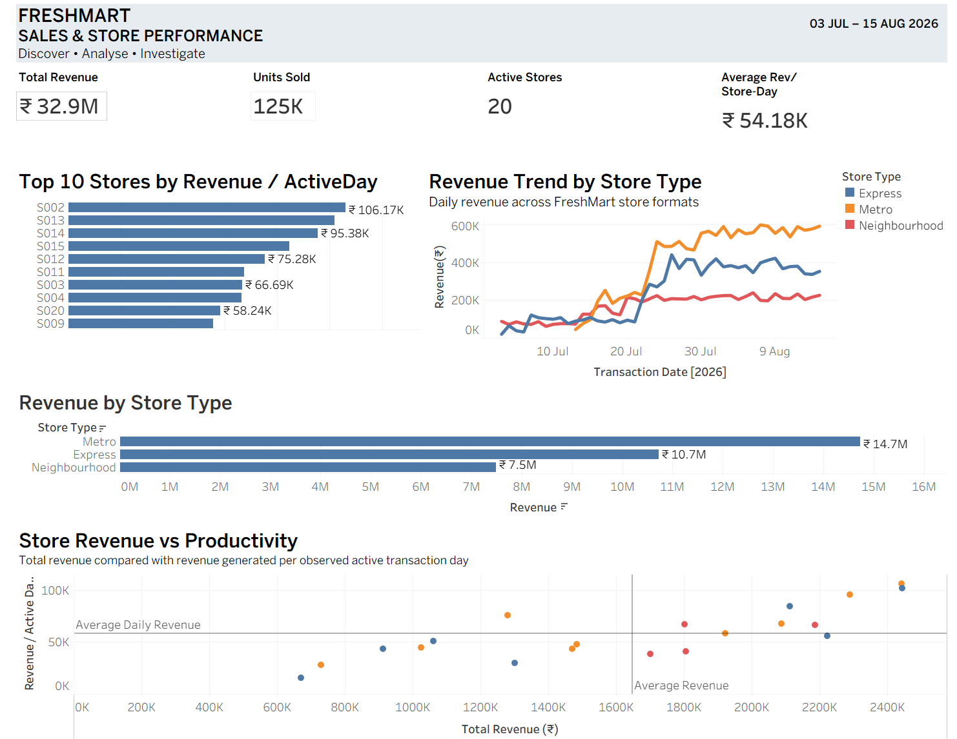

Slide 30
DISCOVER → PREPARE
Our analysis assumes that this data can be produced reliably, consistently, and repeatedly. But at this point, we have not established that
Lab 1 turns these findings into an orchestrated, validated, versioned pipeline and a feature store — from this same extract.
19
From Pipelines to Production · Day 1 · M2 Anchor
Notes:
Answered: what is in FreshMart's data, which stores really drive it, and which signals a reorder model needs, each proven in code. Lunch, then Lab 1 at 13:15. Keep the freshmart_m2 folder; Lab 1 can point its clean stage at the same extract.

Slide 31
https://github.com/paypal/data-contract-template/blob/main/docs/README.md?
This isn't just a theoretical concept. PayPal published a data-contract template based on how they use data contracts. The project has subsequently evolved into the Open Data Contract Standard

